Slide 1
26년 5월 연구미팅 자료 진명

Slide 2


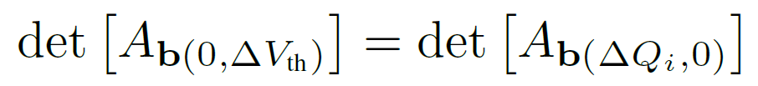
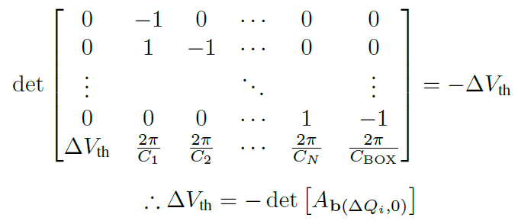
Time-step-free Model Impact
ΔV_{th} Calculation Optimization
ΔV_{th} : Equivalent channel field intensity
By Cramer’s rule,

Slide 3
Time-step-free Model Impact
Property
Transient TCAD
Time-step-free model
Temporal
treatment
Sequential
time stepping
Closed-form evaluation
Final-time
dependence
Runtime grows as
simulated retention time increases
Independent of final
physical time for fixed queries
Average
runtime
27483 s
3.926 s
≈ 7000×
runtime reduction
TCAD 는 final physical time까지 time step 별 순차적으로 계산
Time-step-free model은 closed-form evaluation
Computational resource는 final retention time 자체가 아니라 trap bin 수와 evaluated time point 수에 의해 결정

Slide 4
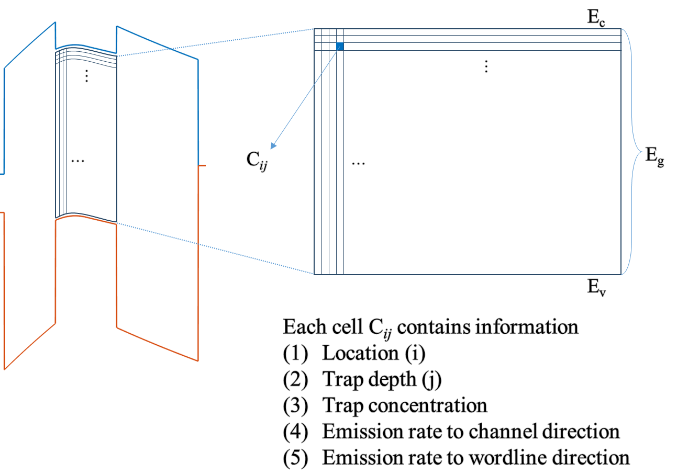
Time-step-free Physics-based Modeling
Main Idea: simulation done with initial condition
=> different from time stepping transient simulation
1. Initial state
n_{t0}(r, E_{t})
2. Emission rates
e_{ch}, e_{WL}
3. Direct evaluation
n_{t}(r, E_{t}, t)
계산 비용은 final retention time 자체가 아니라
trap bin 수와 evaluated time point 수에 의해 결정

Slide 5
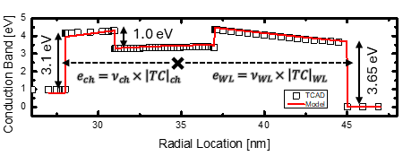
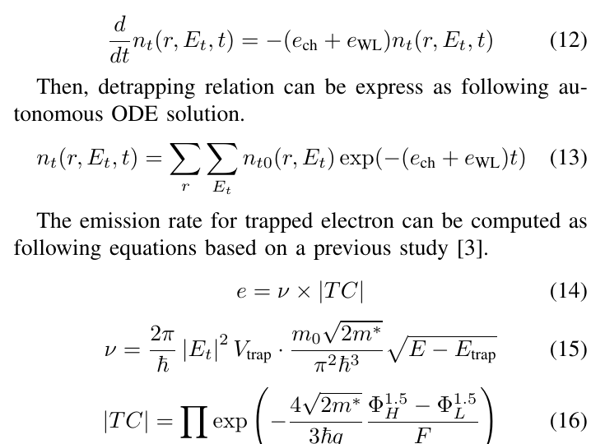
Time-step-free Physics-based Modeling
Main Idea: simulation done with initial condition
=> different from time stepping transient simulation
1. Initial state
n_{t0}(r, E_{t})
2. Emission rates
e_{ch}, e_{WL}
3. Direct evaluation
n_{t}(r, E_{t}, t)

Slide 6

Time-step-free Physics-based Modeling
Main Idea: simulation done with initial condition
=> different from time stepping transient simulation
1. Initial state
n_{t0}(r, E_{t})
: Autonomous ODE
Detrapping Autonomous ODE
2. Emission rates
e_{ch}, e_{WL}
3. Direct evaluation
n_{t}(r, E_{t}, t)
Initial state
closed-form evaluation
computation resource는 final retention time 자체가 아니라
trap bin 수와 evaluated time point 수에 의해 결정

Slide 7
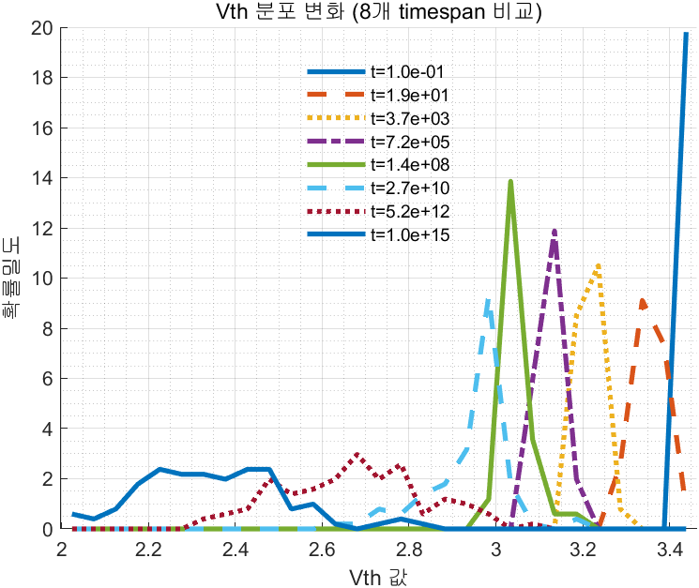
ΔV_{th} Simulation over Variations
ΔV_{th} Simulation over TOX variations
Trap Profile
Shallow trap retention variation dominant
Shallow Trap:
narrow distribution, fast
Initial V_{th}
Deep trap retention variation dominant
Deep Trap:
wide distribution, slow
Initial V_{th}
Deep trap retention distribution widening starts

Slide 8
Future Works
Extension to more parameter variations >> TOX 이외의 CTN, BOX 두께, trap profile 등의 여러 변수들에 대해서도 산포 변화 분석
Time dependent sensitivity analysis of retention loss >> shallow/deep trap에서의 시간에 따른 dominancy가 어떻게 변하는지
Statistical Modeling of Vth distribution evolution >> 각각의 변수들이 산포의 표준편차에 반영되는 정도를 모델링

